Slide 1
Boosting Algorithm

Slide 2
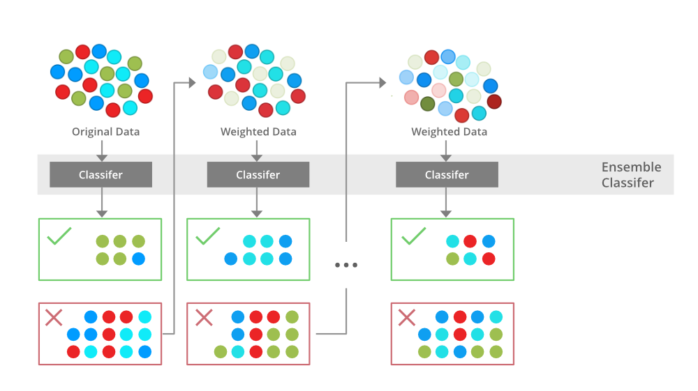
Boosting is a supervised machine learning strategy that combines the predictions of multiple weak models (base models) to generate a powerful ensemble modeI. n a class, a teacher focuses more on weak learners to improve its academic performance to make them stronger, similarly boosting works.

Slide 3
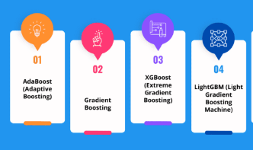
Types

Slide 4
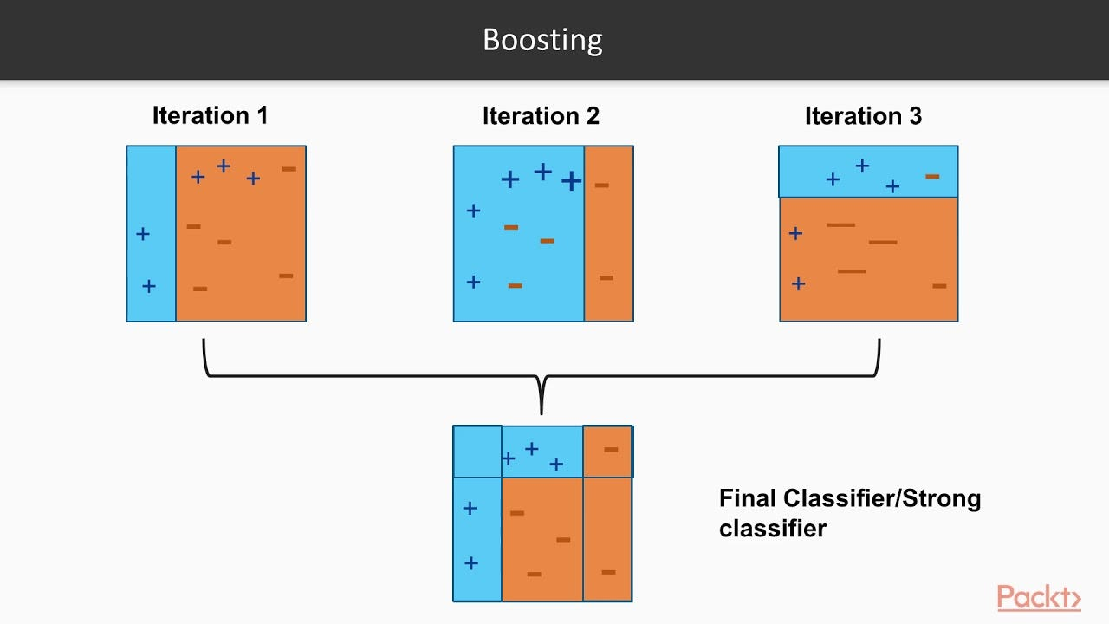
ADABOOSTING
The process involves training a model with training data and then evaluating it. The next model is built on this which tries to correct the errors present in the first model. This procedure is continued and models are added until either the complete training data set is predicted correctly

Slide 5
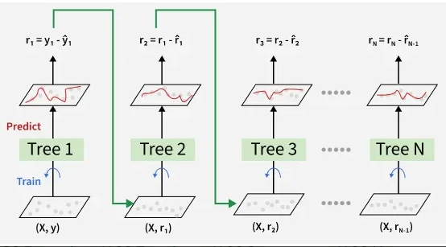
Gradient Boosting
ypred​=y1​+η⋅r1​+η⋅r2​+⋯+η⋅rN​

Slide 6
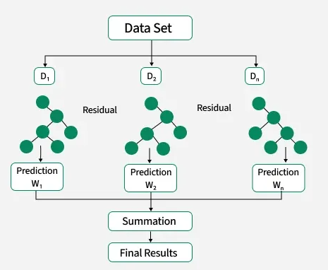
XGBoosting

Slide 7
LightGradient Boosting
Works for large dataset

